Slide 1
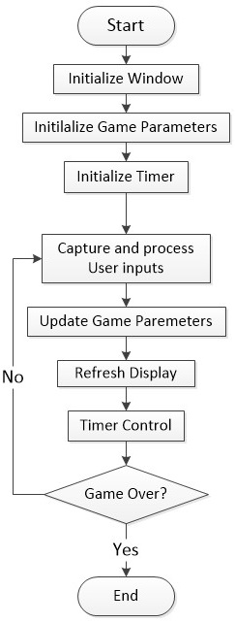
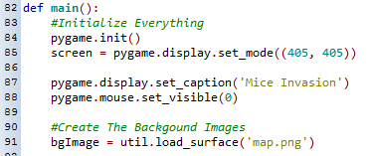
Initialize the gaming window
Prepare the background image

Slide 2
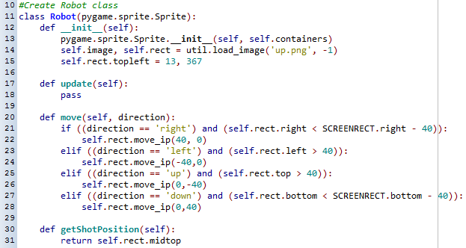
Game Parameters – Game Characters Class - Robot
Prepare image and initialize starting position
Move the robot on demand
Obtain the current position of the robot to place the starting position of the bullet

Slide 3
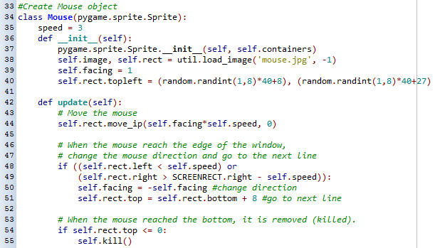
Game Parameters – Game Characters Class - Mouse
Set the speed of the mouse
If the mouse is at the edge of the window, move down one step and change direction
Prepare image and initialize the moving direction and starting position
Move the mouse
If the mouse hits the bottom of the window, remove the mouse

Slide 4
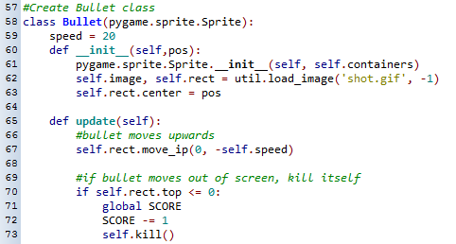
Game Parameters – Game Characters Class - Bullet
Set the speed of the bullet
Prepare the image and set the starting position
Move the bullet up one step
When the bullet reach the top of the window, remove the bullet

Slide 5

Game Parameters – Method for displaying Text

Slide 6
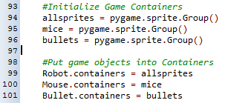
Game Parameters – Sprite Containers
Create game containers
Place the game objects into the containers

Slide 7

Game Parameters – Initial game objects
Create a robot and a mouse
Game Parameters – Game Over status
Initialize the game over to be false

Slide 8


Slide 9
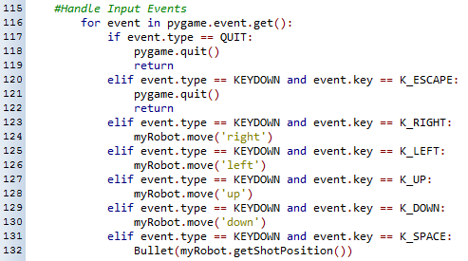
Capture user quits
Capture arrow keys and move the robot
Capture space to fire a bullet

Slide 10
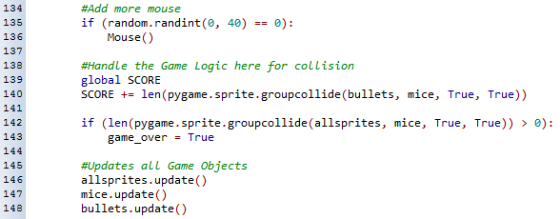
Randomly add more mice
Check the collision between mice and bullets,
Update score at the same time
Update all the game characters

Slide 11
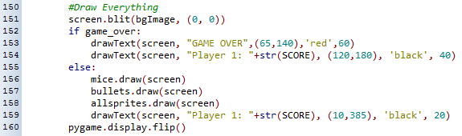
Refresh the background image
Refresh all the game characters
Display the player score

Slide 12

Control the framerate

Slide 13

Check for collision between the robot and mice
Display game over and final player score

